Slide 1
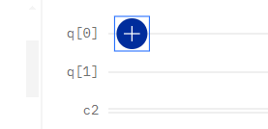
Path X gate
Simply made with four mirrors

Slide 2

Polarization X gates are a special case of this gate, where 𝛉=90 degrees
𝛉
Polarization H gates are also a special case of this gate, where 𝛉=45 degrees
𝛉
Polarization RX gate
Two waveplates acting on each beam, rotating the polarization by a set amount

Slide 3
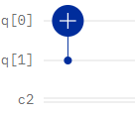
𝛉
𝛉
𝛉
𝛉
CX gate, Polarization to path
Same as the X gate, but with polarizing filters to allow the chosen polarization through.
To follow with our standards, the filters are horizontal, reflecting (and therefore swapping) vertically polarized photons

Slide 4
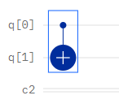
𝛉
CX gate, Path to polarization
This gate follows from the observation that a photon will not interact with a filter that it does not cross, thus with a single filter on a single beam a CX gate can be created.
𝛉=90 degrees

Slide 5
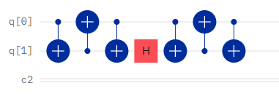
While polarization RX gates are fairly simple, path RXgates are not. They require the following OpenQASM code, swapping qubits and doing the operation on the polarization qubit, then swapping again and continuing with the operation. Using an H gate in this example.
cx q[0], q[1];
cx q[1], q[0];
cx q[0], q[1];
h q[1];
cx q[0], q[1];
cx q[1], q[0];
cx q[0], q[1];
Significant optimization will be required for this. Fortunately cx q[0], q[1] should be the most optimized gate.

